Slide 1
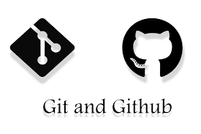

Slide 2

firstly ,Git is not the Github (:

Slide 3

What is Git ?
Git is a free and open source distributed version control system designed to handle everything from small to very large projects with speed and efficiency“

Slide 4

What Is GitHub?
it’s been said that GitHub is to Git what Facebook is to your actual face. What’s that mean? Well, it means that while Facebook is kind of like an online face database (of sorts).
GitHub is designed as a Git repository hosting service.
"GitHub is a web-based Git repository hosting service, which offers all of the distributed revision control and source code management (SCM) functionality of Git as well as adding its own features.“

Slide 5
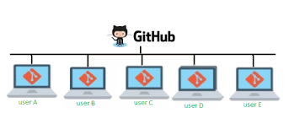
Briefly…

Slide 6
